Slide 1
Receive System Signal to Noise Ratio Optimization
JEY Labs Presents-
Doug Millar K6JEY

Slide 2
Receiver System Optimization LF through Microwave
These are techniques for optimizing your receive system from antenna to speaker on any band.
It reveals problems with
interstage gain
compression.
Receiver sensitivity
Optimizes noise figure
Measures audio distortion in the receiver
Reveals cable losses

Slide 3
Definitions
Noise figure
A relative DB measurement of RF signals using a hot and cold source to excite a receive chain. Requires a noise source and detector/indicator unit.
SINAD (https://en.wikipedia.org/wiki/SINAD)
A standard radio measurement of Signal to Noise ratio. Uses a modulated input signal to calculate the db difference between the signal and average noise at a specific signal level.
S/N
Signal to Noise ratio. Simple measurement of the difference between a signal and the average noise.

Slide 4
Equipment Needed
RF Generator for the system tested
1Kc Audio generator that modulates the RF source
Distortion or S/N meter or indicator.

Slide 5
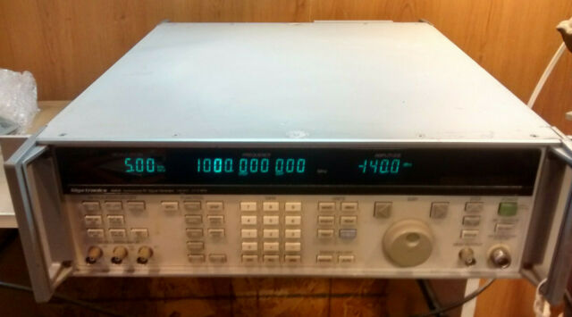
Examples of RF Sources
RF Signal source modulated with a 1KHz tone and adjustable output level in AM or FM mode
Examples-
Gigatronics 6082A
0.1-2000MHz

Slide 6
HP 8614A .8-2.4GHz

Slide 7
Lower Frequeny Signal Gen. URM 25 Cheap and easy

Slide 8
Alternate Signal Sources
Signal source with no modulation ability-
Use an RF mixer and inject a 1KHz signal into the IF port and RF into the LO port.
A PIN diode switch can also be used for modulator.
Signal source at too low a frequency-
Use a harmonic. All we need to have is a demodulated 1KHZ tone and noise.

Slide 9
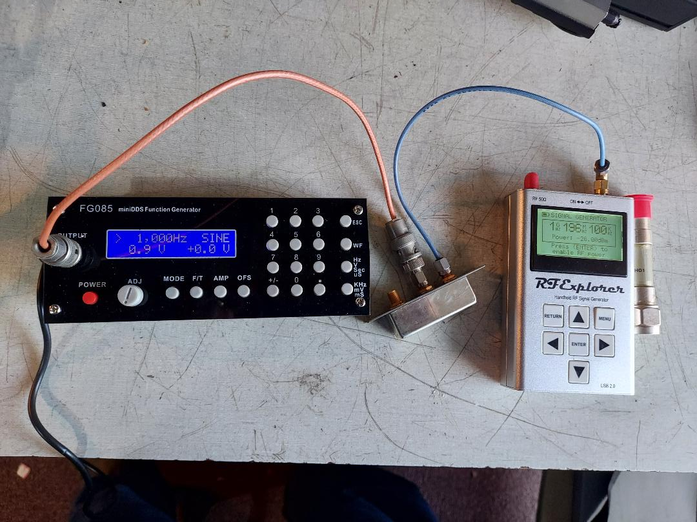
RF Explorer Signal Generator
Using AF gen for 1KHz and mixer
Cheap Audio gen
RF Explorer
Sig. Gen.
Use an ext.
Step Atten.
Mixer

Slide 10
Leader Audio VM and Audio Gen.

Slide 11
Distortion Analyzers Heathkit Manual Harmonic HD-1 or IM-58
Gives harmonic
Distoriton in %
Put in Audio with tone’
Set level
Switch to Dist.
Tune for a null
Read Distortion
Repeak manually

Slide 12
Leader Semi Automatic Distortion Analyzer LDM171
Automatically nulls in
The lower ranges.
Still a little fiddily
But less than the
manual version

Slide 13
TDM-1911 Automatic Analyzer

Slide 14
Collins Analyzer 476D-1
Totally and
Completely
Over the top

Slide 15
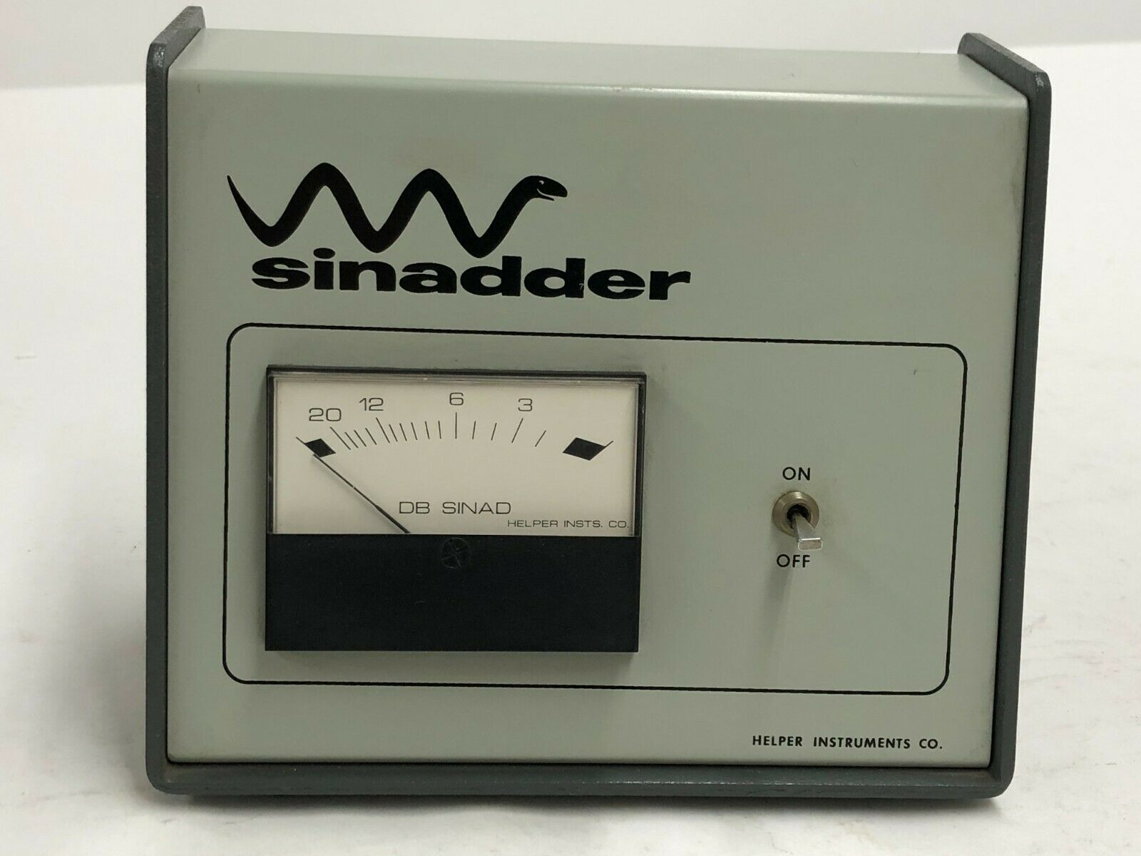
SINADDER
A simple harmonic distortion analyzer.
Uses an ext. 1KHz tone.
Reads in SINAD- 12db Sinad@ sig gen output level.
You change The generator
output to keep the meter
at 12db SINAD
Accurate enough AM/FM
System S/N ratio.

Slide 16
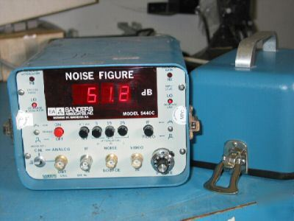
System Noise figure Method
The Sanders system noise figure meter measures the NF of a receiver system from antenna to speaker.
Simple and easy to use.
Requires a noise source
Adjust for best noise figure
The HP8070a/b won’t do this.

Slide 17
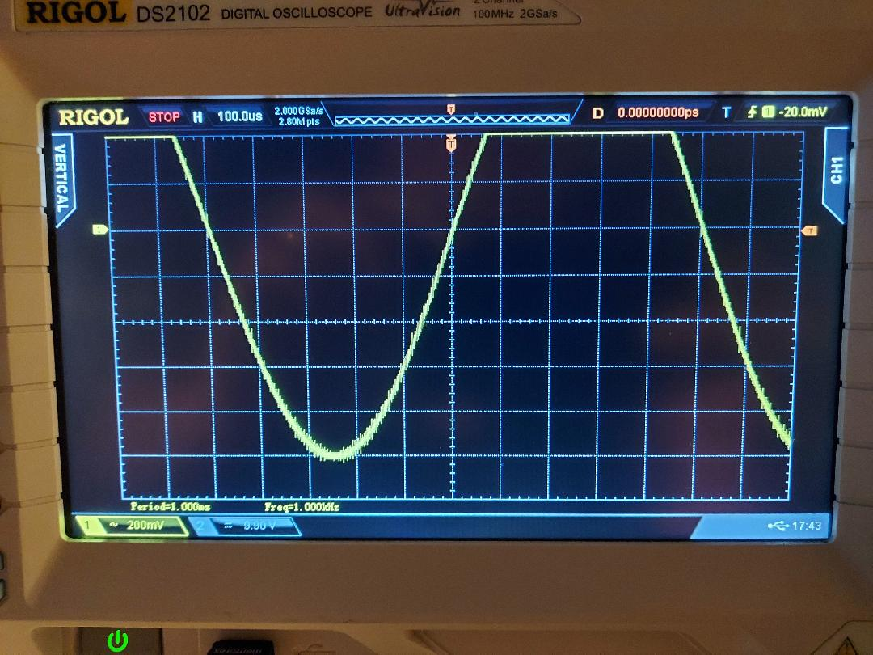
Oscilloscope Method (FM)
Use an enlarged sinewave and observe the bottom of the loop to see quieting with a 1KHz tone.
Sig Gen and radio should be in FM mode.
Tune the system
for least noise
on the loop.
Easy to use

Slide 18
ComTekk analyzer software
Software- uses sound card input
$39 for hams- per computer
Best deal of all!
Measures everything-THD, SINAD, SNR,
IMD, ETC.
It has a 1KHz tone output for your signal
Generator
Has a spectrum analyzer.
A separate USB DAC may help on a
laptop computer.
Website-
http://comtekk.com/sinad.htm

Slide 19
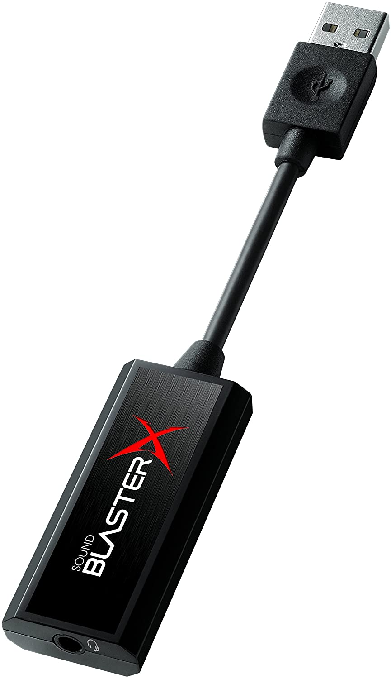
Creative Sounds
USB Sound Card
Vastly improves laptop sound card
quality.
24 bit 96KHz DAC converter
Good for digital modes.
It is $24.
Don’t go cheap.

Slide 20
System Test Setup Example
Signal Generator with AM/FM 1kc modulation.
1296MHz low noise preamp
Actual coax and relays to the receiver (IC9700)
Second Preamp
Attenuators
All measurements are done at the audio output
The radio is in the AM or FM mode
With preamp on or off

Slide 21
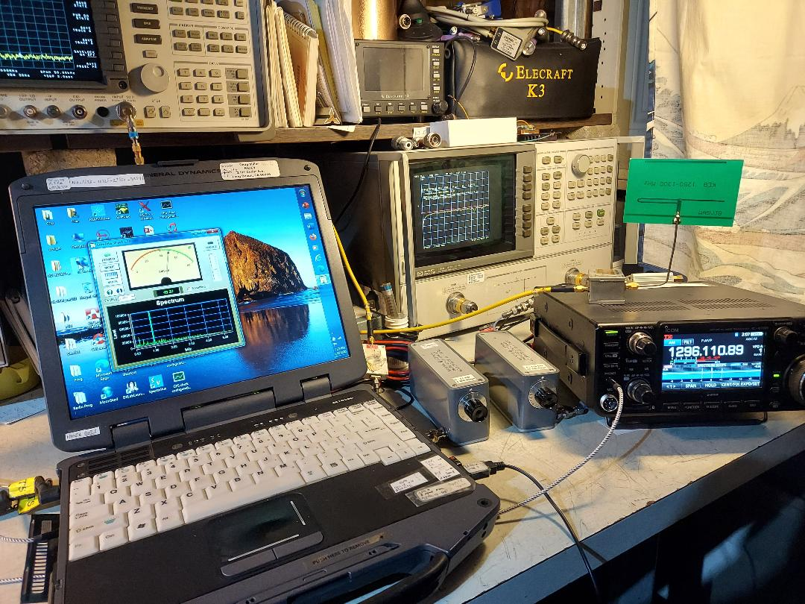
ComTekk 1296MHz Setup
GD 8200
Computer
HP335
Attenuators
Preamp
Antenna
IC9700 in AM
Signal Generator
On 1296.1MHz
AM mode.

Slide 22
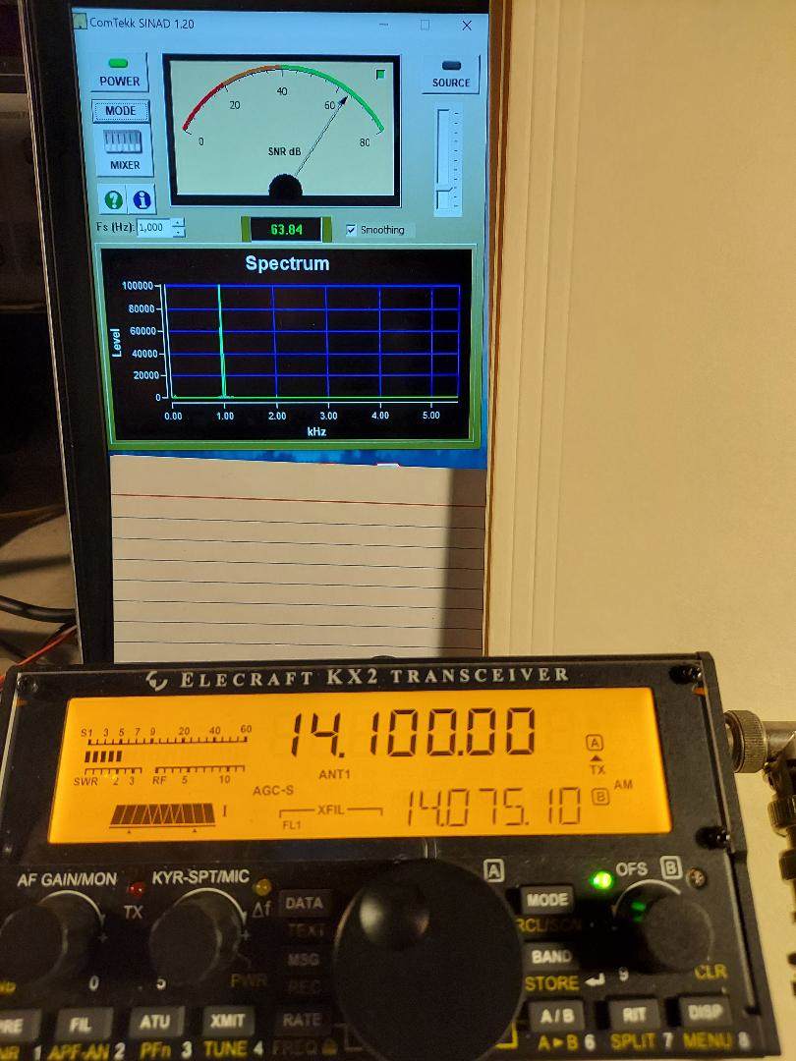
ComTekk with
An Elecraft KX2

Slide 23
Techniques and equipment used to adjust the system for best S/N
.

Slide 24
Process for Distortion measurement
Set up equipment and RF components so that the detected 1KHz signal is available at the speaker.
Do not go direct, use antennas.
Adjust level and volume to give a full scale set level
Switch to distortion measurement
Adjust all RF stages in the receiver and RF chain for best distortion %.
Record set up and results.

Slide 25
Process For
S/N Measurements
Use antennas on the radio and signal generator
I found a good adjustment range from
.65% distortion to .15%
or about half the meter’s scale.
Remember to repeak the level when
the generator level is
changed.
The 9700 is in AM mode.

Slide 26
By Ear
You can adjust the S/N by ear.
It is not accurate, but works
Set Signal to just perceptible level.
Adjust attenuation/gain for clearest signal.
The setting is different for loud and weak sigs.

Slide 27
S/N improvement with IC 9700 Noise Reduction Control
ICOM IC9700 has an excellent DNR control
Turning on the control gives 6db improvement in S/N.
(VA7OJ Test Report https://bit.ly/2NxzaS4)
New mode of Spectral subtraction does it.
Not a cure for gain compression.

Slide 28
Product Detectors
If your IF radio has point contact diodes in the product detector in the RX (1N60) Change them out.
Use Schottky diodes like the 5082-2800 or 2900 series. (5082-2835, 2917)
The RX distortion below 1KHz will go from 30% to below 1%.

Slide 29
MC1496 Product Detectors
Another option is to use the Motorola MC1496 product detector instead of a quad of 1N60’s.
On Ebay for about $3-
Schematic next slide

Slide 30
MC1496 Product Detector 12v.

Slide 31
Overall Observations
Pick a method that suits your equipment and experiment. I liked signal to noise ratio.
You will find a strong improvement in your system’s weak signal handling abilities.
4-10db of attenuation works between the last
Preamp and the IF radio on my setup.
Get a group together to make measurements on everyone’s radio at a club meeting or “tech party”

Slide 32
Thanks for Watching
Feel free to text or email me at-
drzarkof56@yahoo.com

Slide 33
Many Thanks to
Helen KI6LQV
Bill McNally N6MN
Mel Swanberg WA6JBD
Kent Britain WA5VJB

Slide 34
FIN

